Slide 1
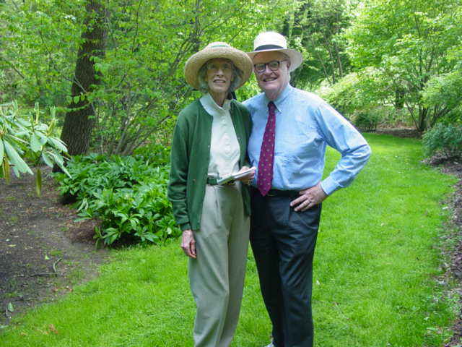
Mary Phipps
Howard Phipps Jr.

Slide 2
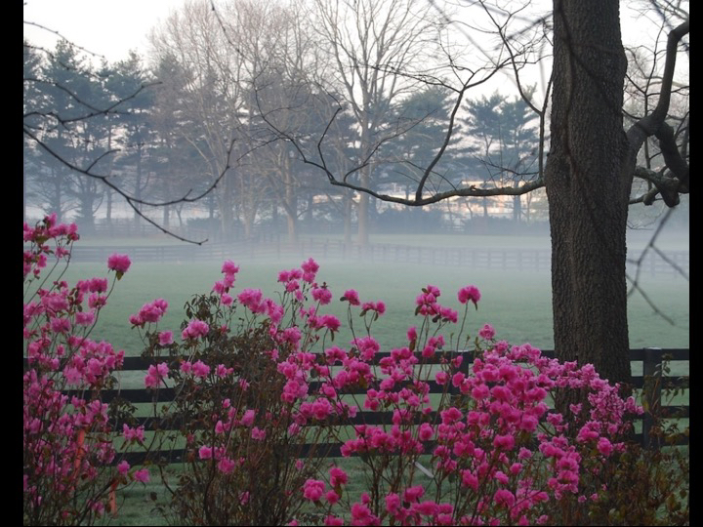

Slide 3
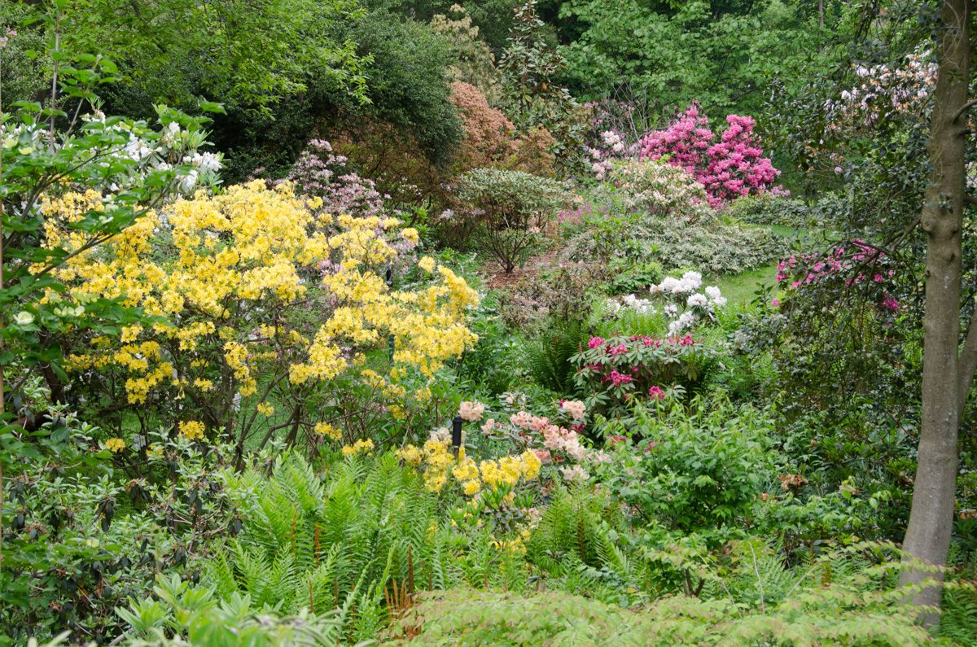

Slide 4
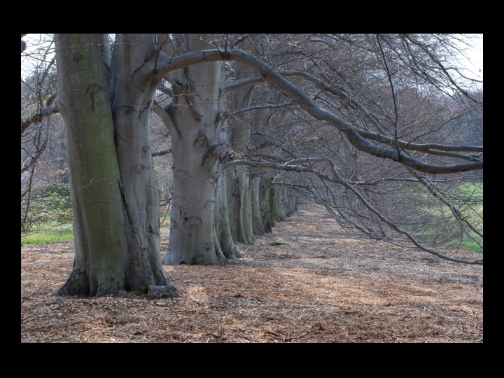

Slide 5
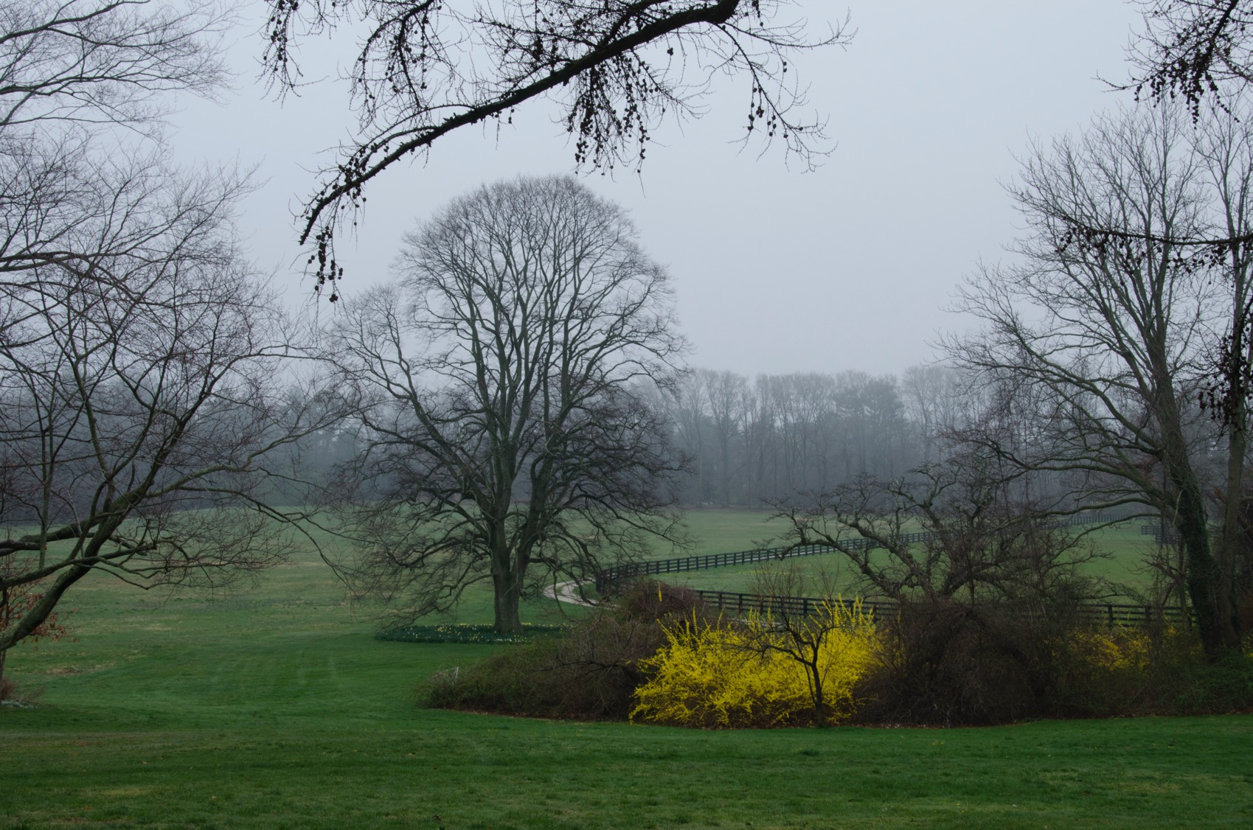

Slide 6
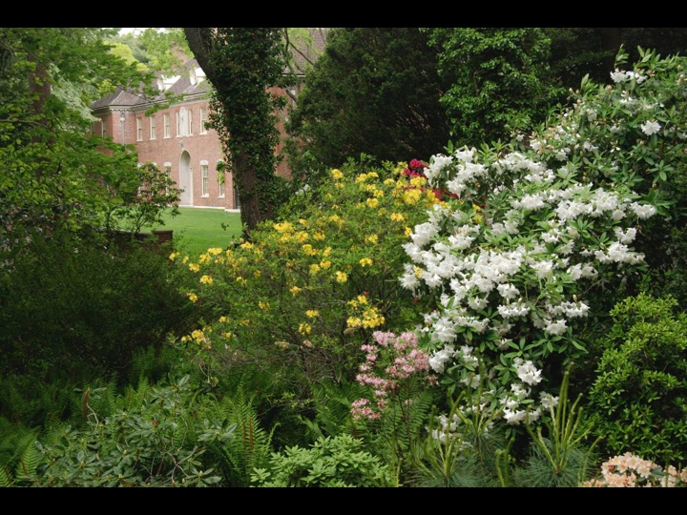

Slide 7
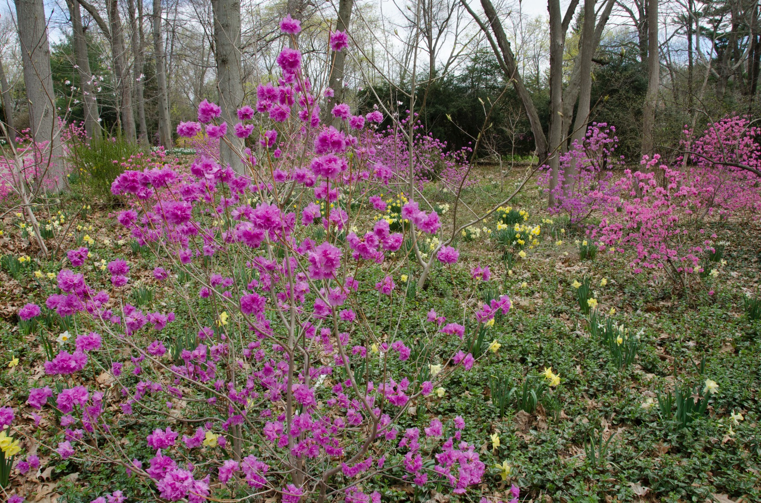

Slide 8
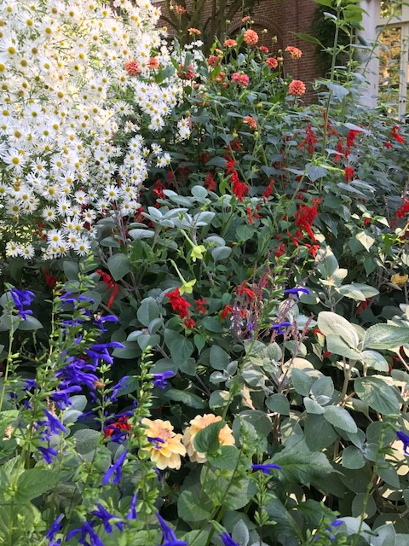

Slide 9
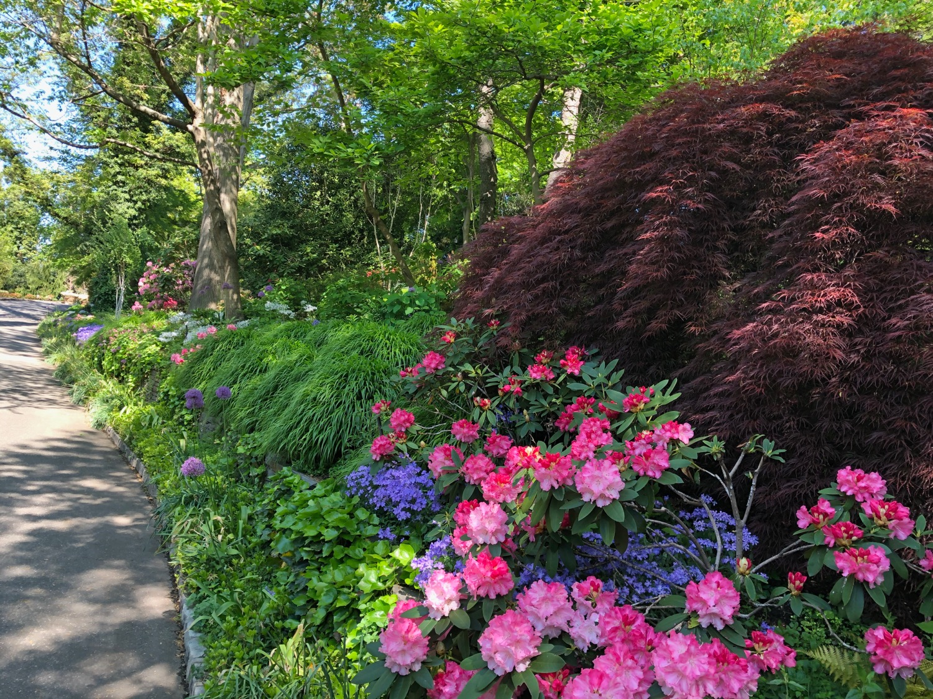

Slide 10
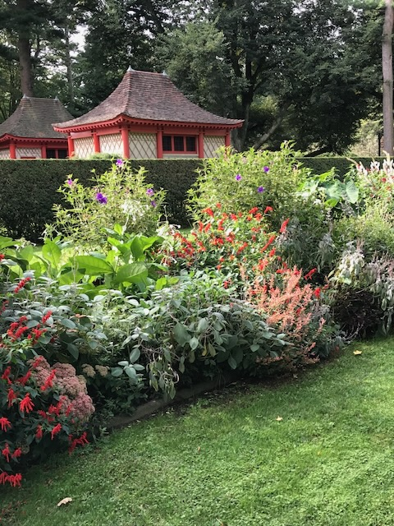

Slide 11
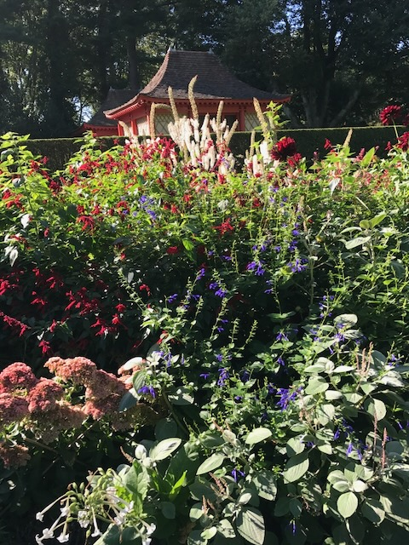

Slide 12
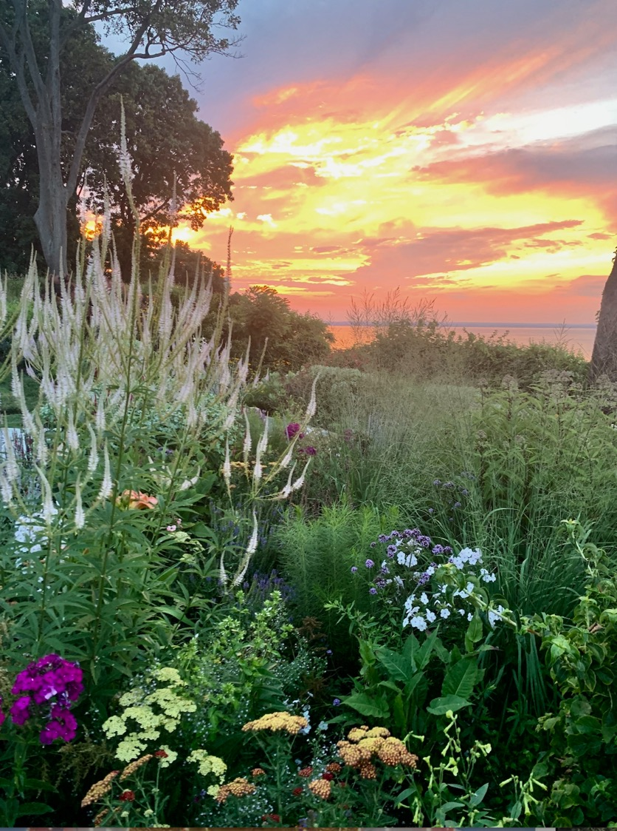

Slide 13
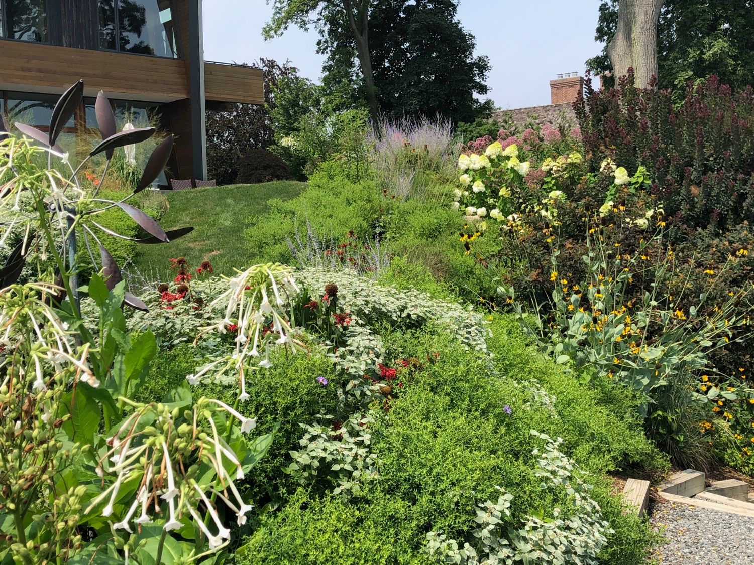

Slide 14
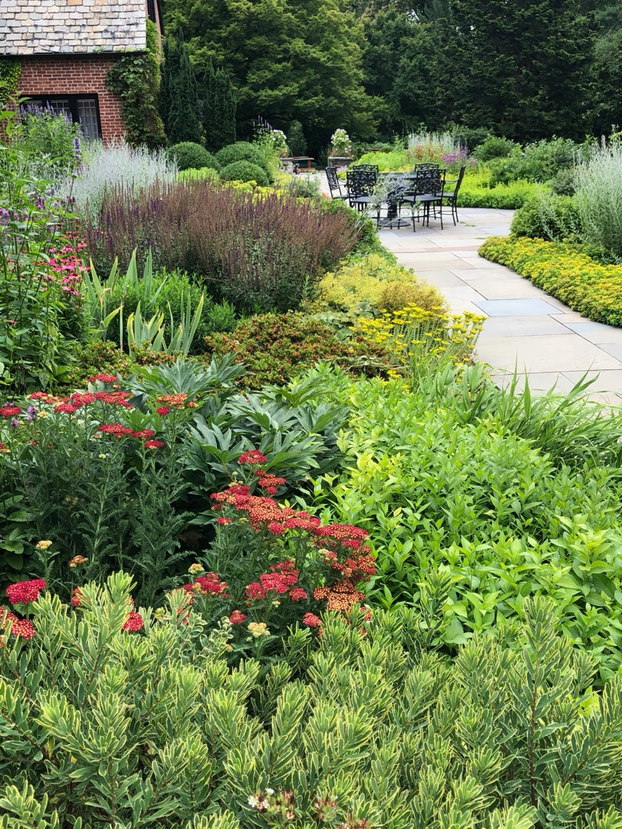

Slide 15
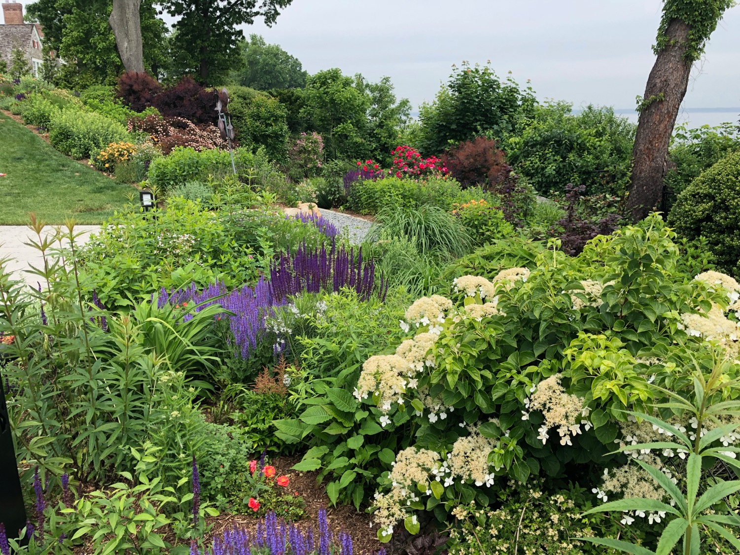

Slide 16
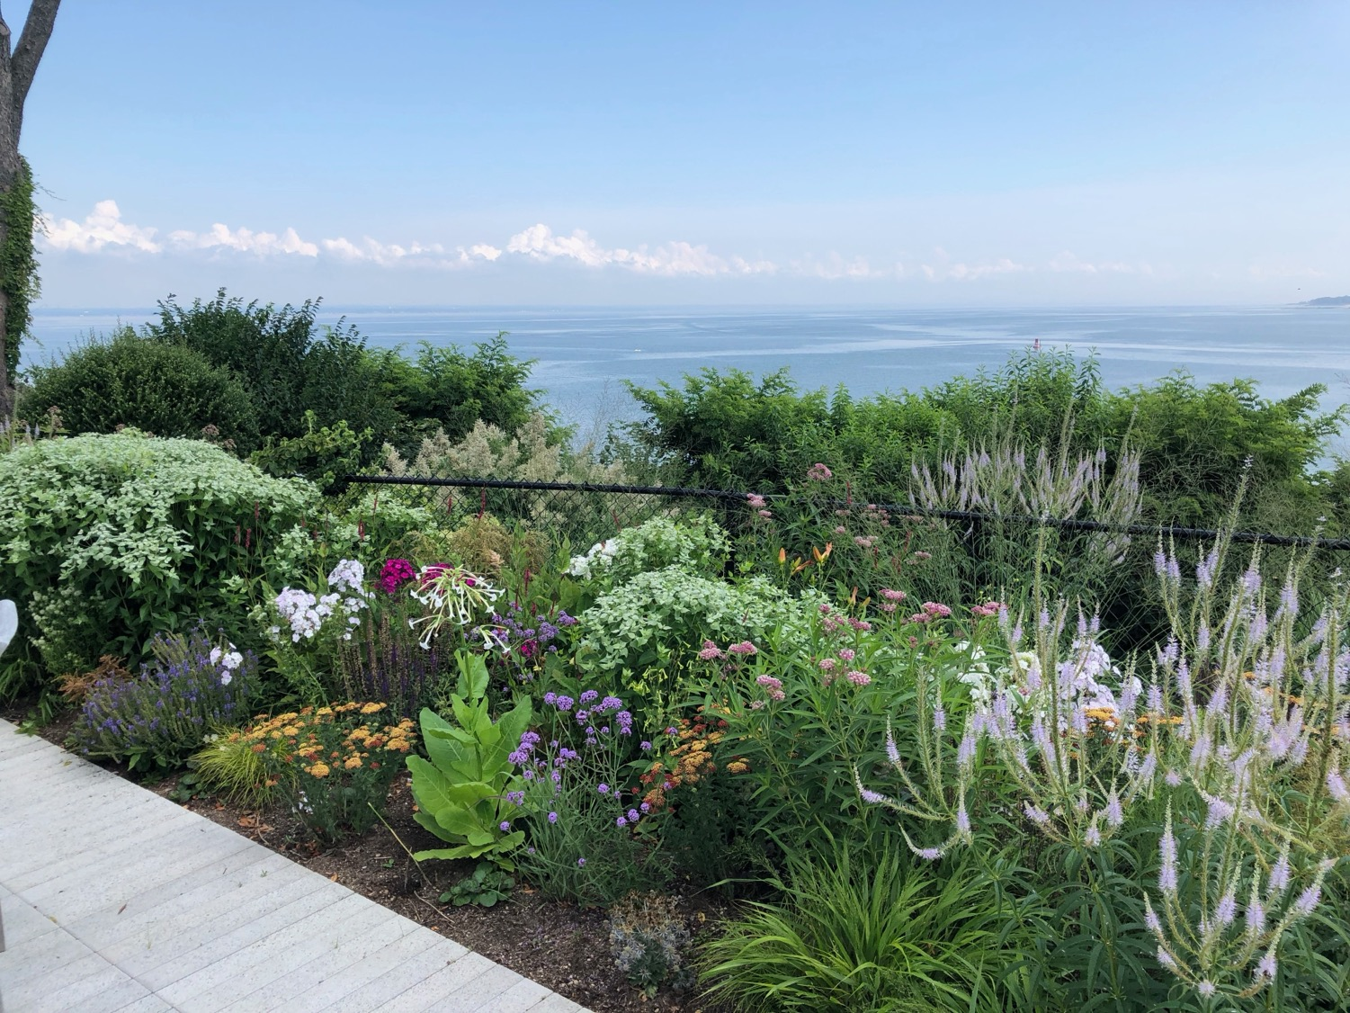

Slide 17
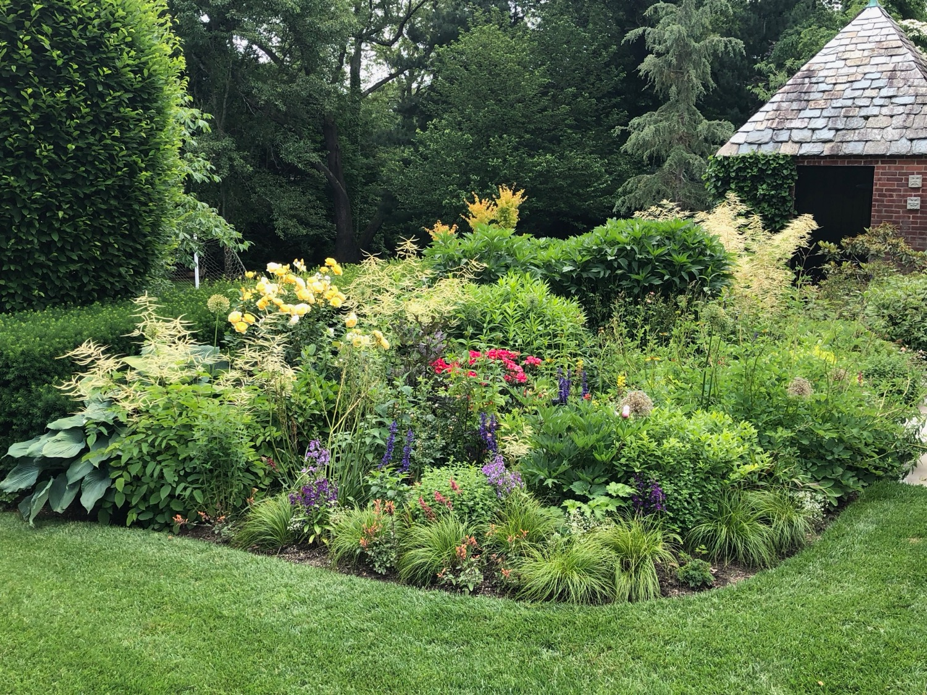

Slide 18
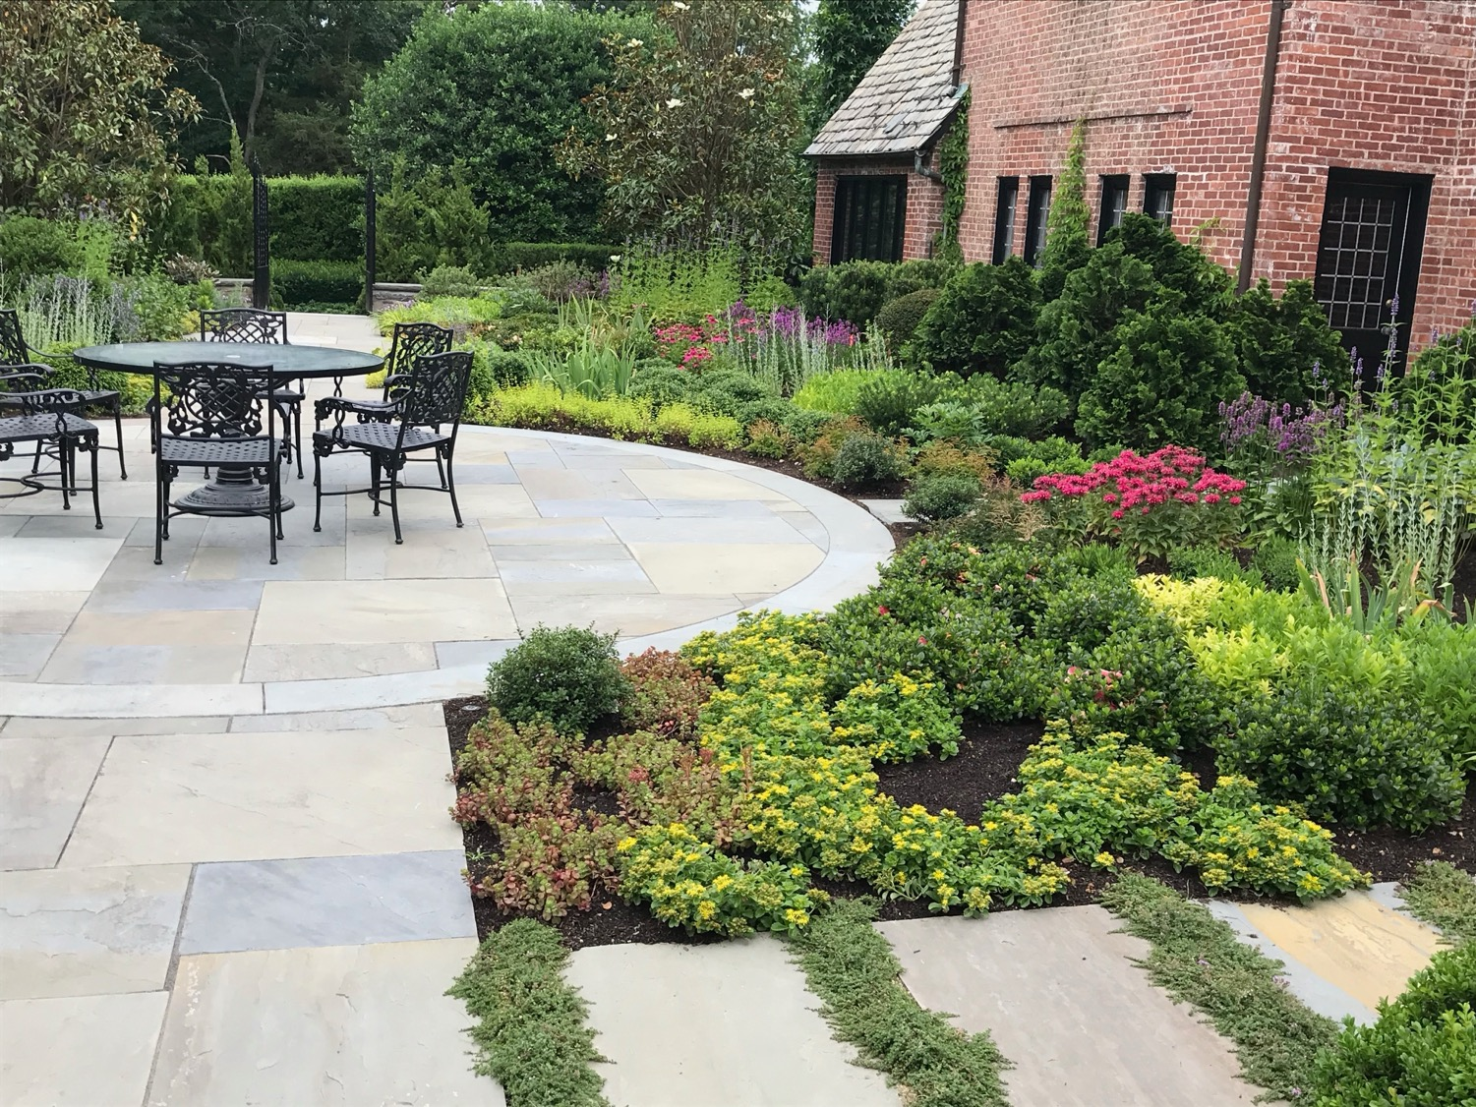

Slide 19
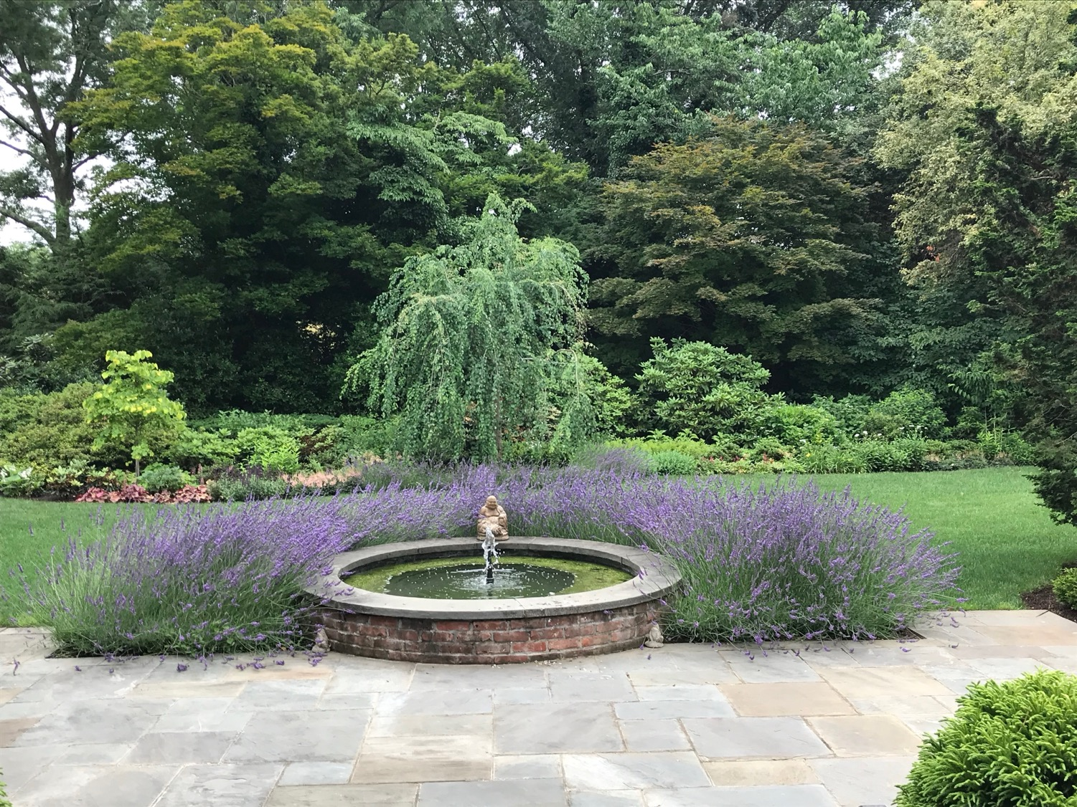

Slide 20
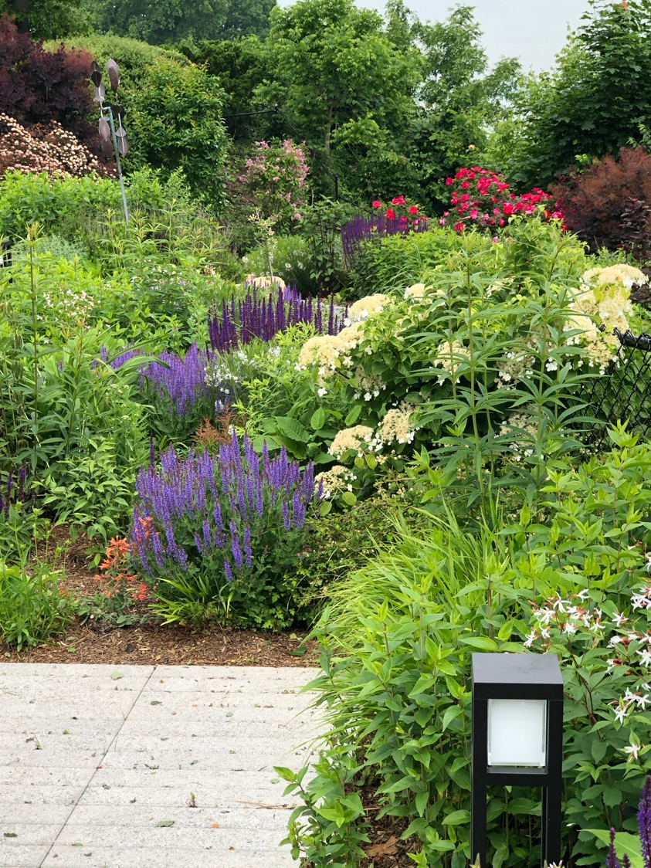

Slide 21
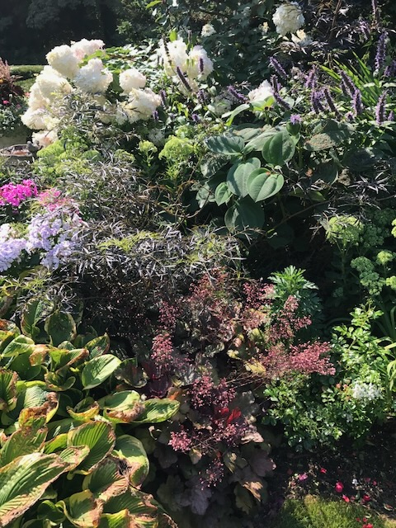

Slide 22
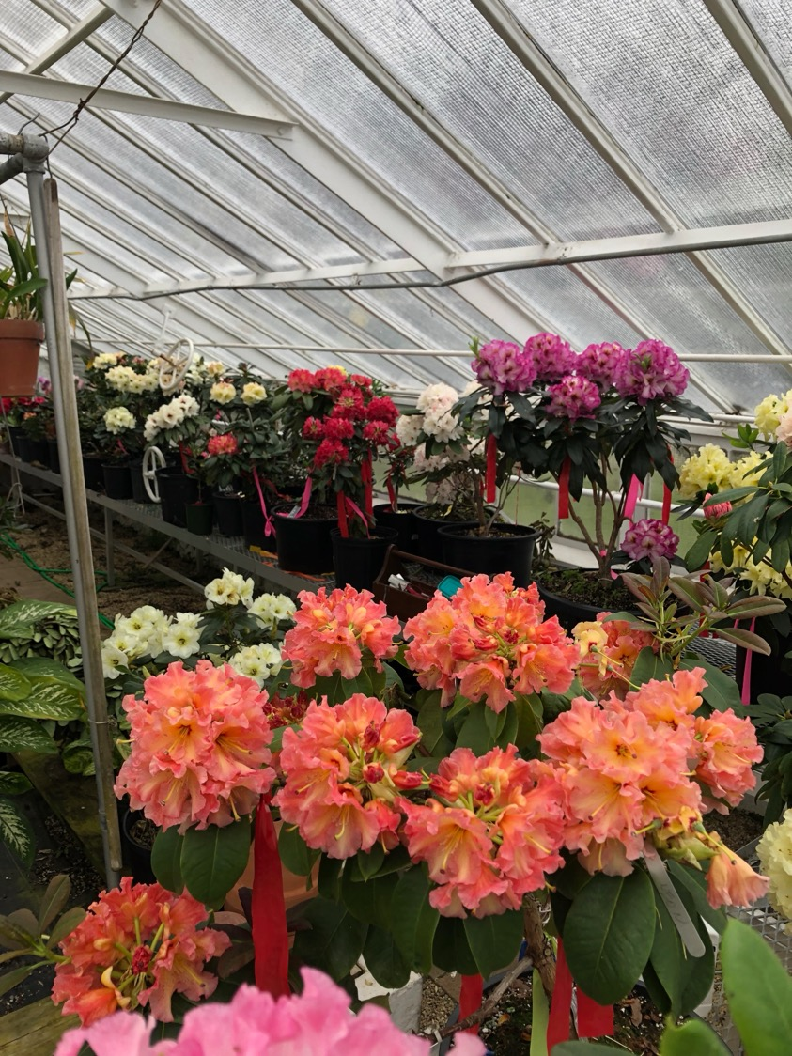

Slide 23
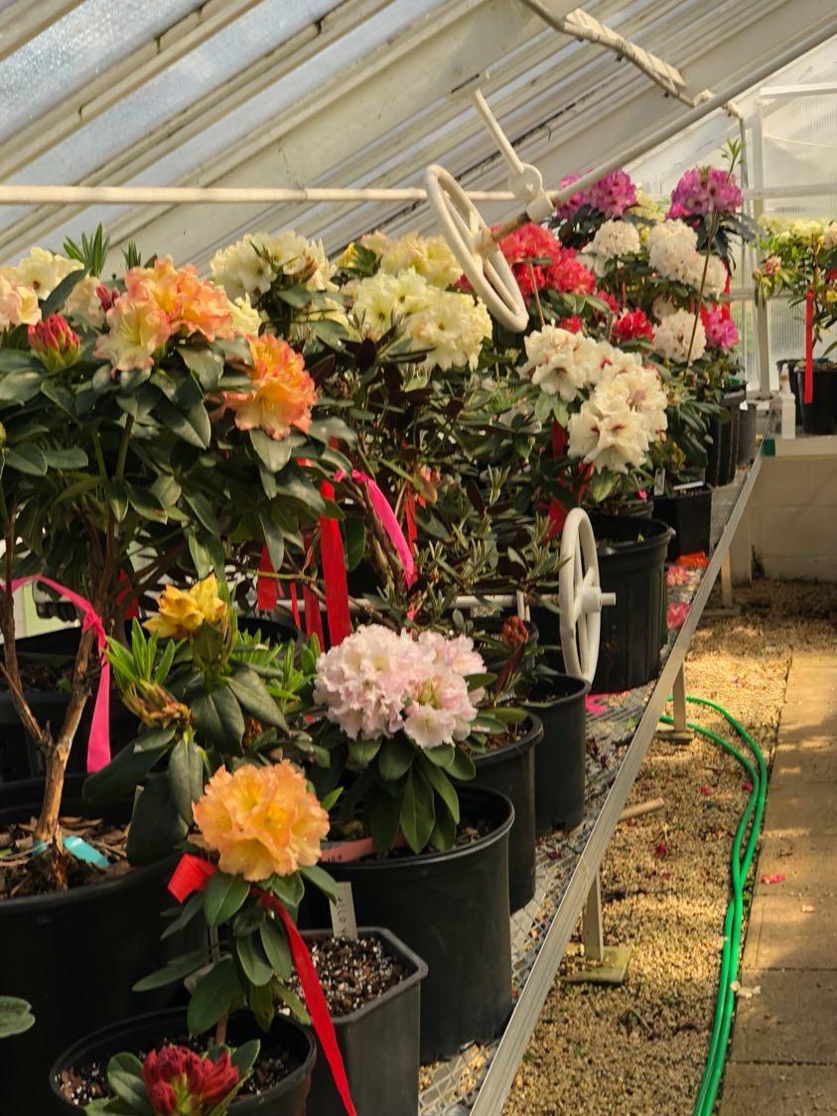

Slide 24
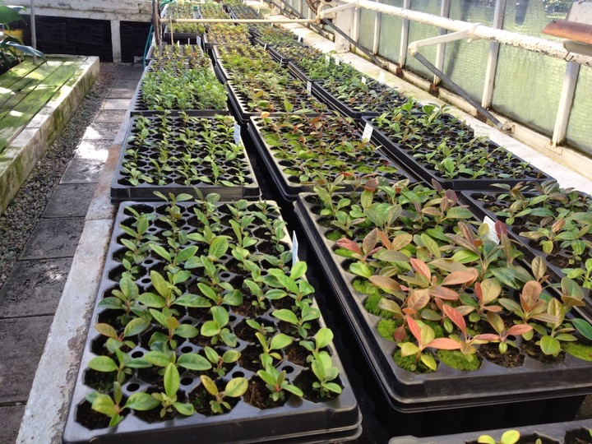

Slide 25
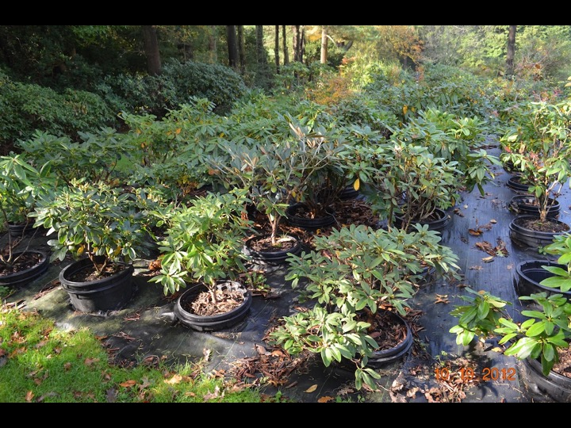

Slide 26
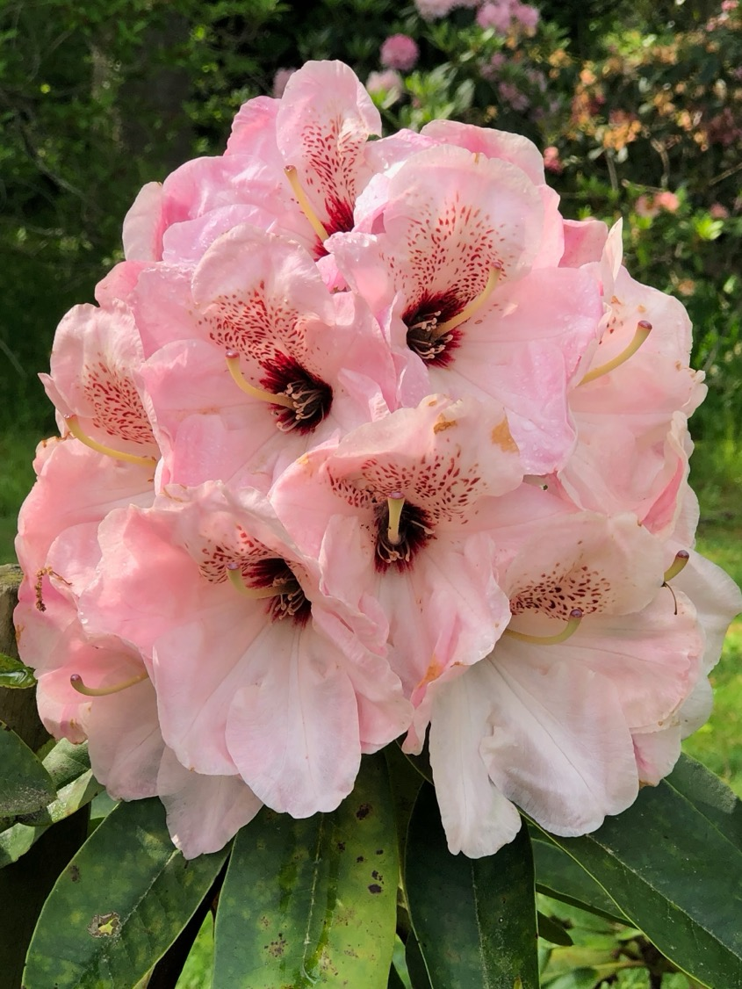
Big As My Head portrait

Slide 27
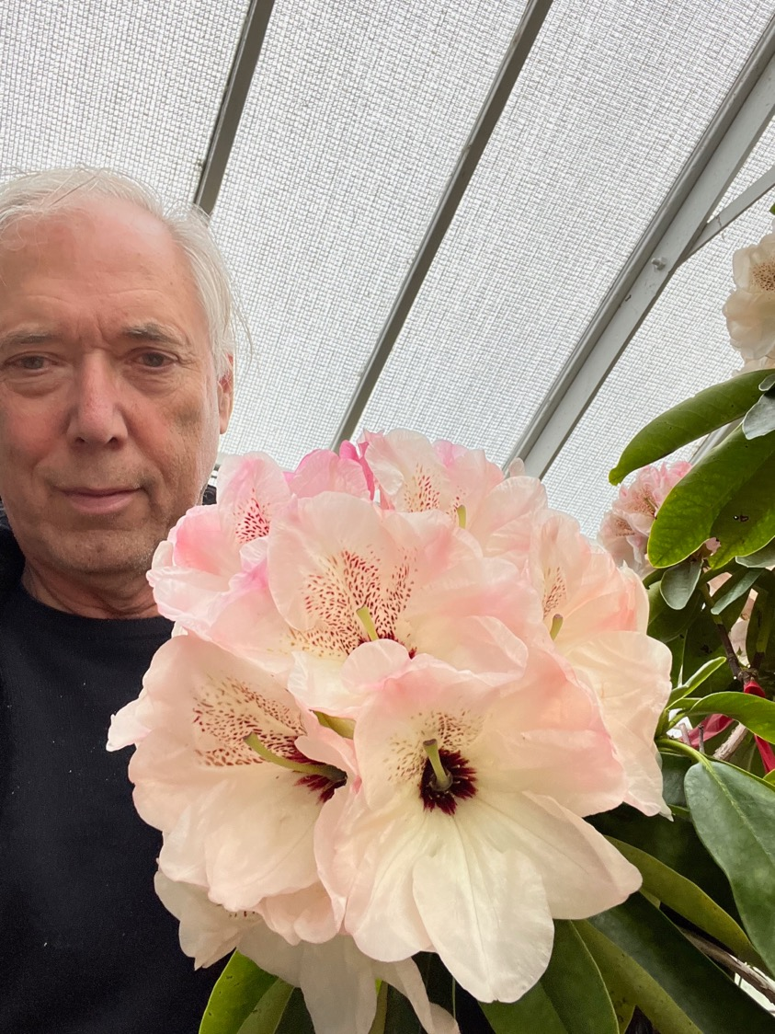
Big As My Head

Slide 28
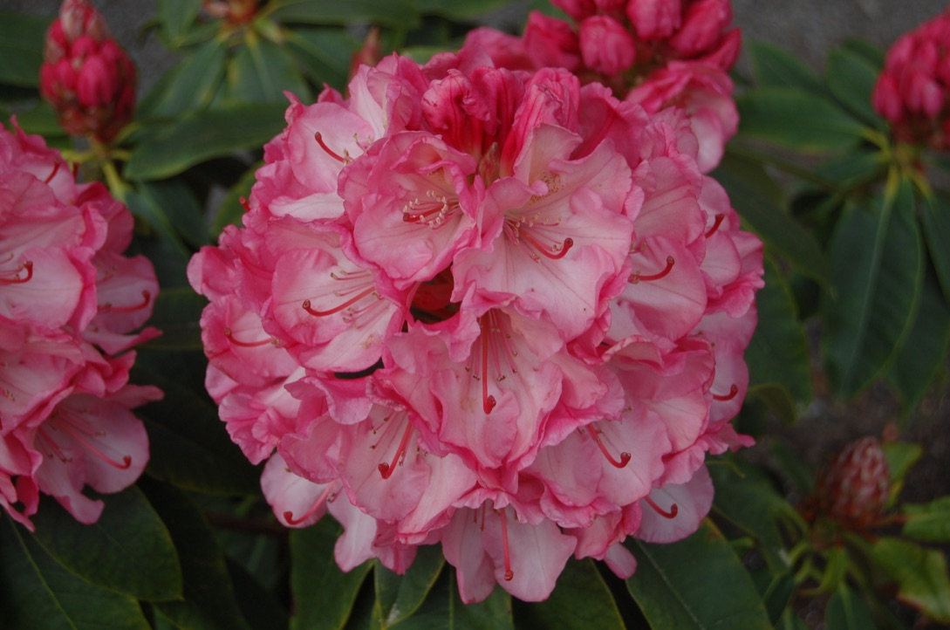
Viennese
Waltz

Slide 29
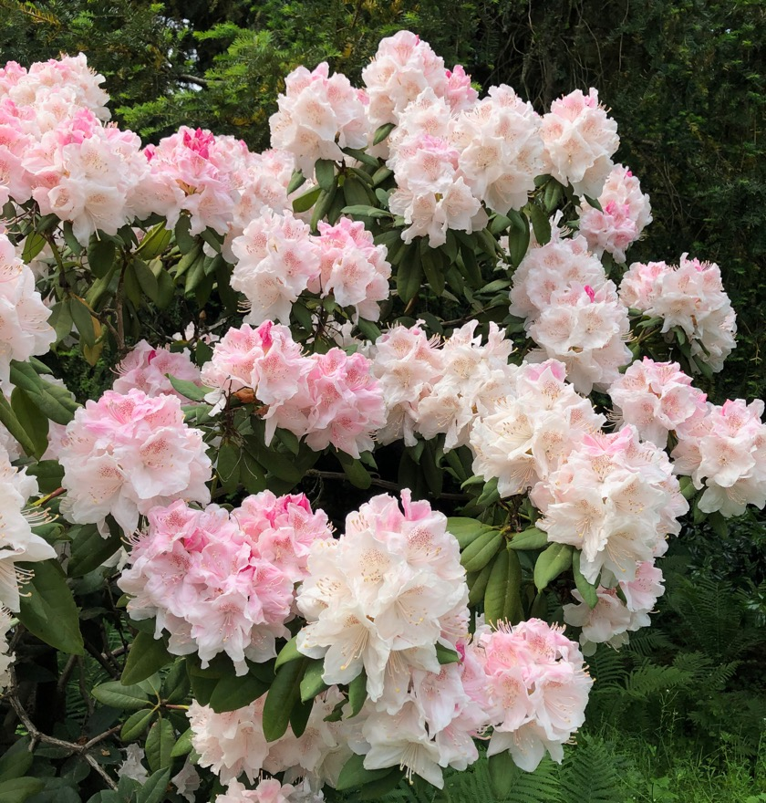
Opal Thornton
(hyperythrum x English Roseum)

Slide 30
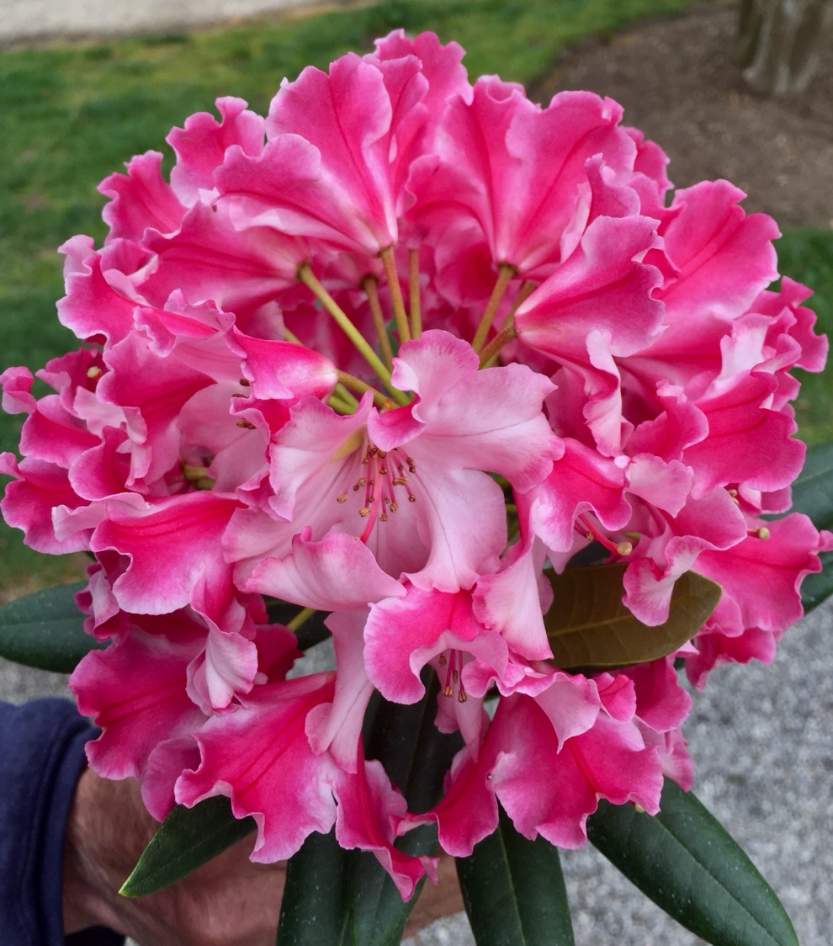
Fantastica x 1000 Butterflies

Slide 31
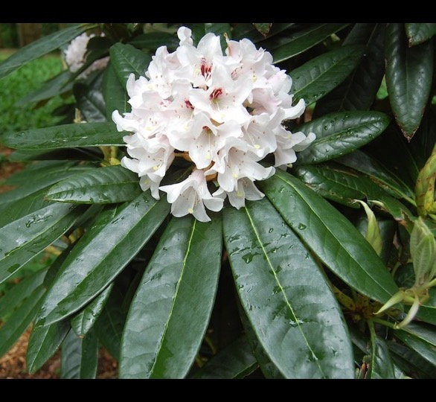
maximum x Calophytum
(Augie Kehr)

Slide 32
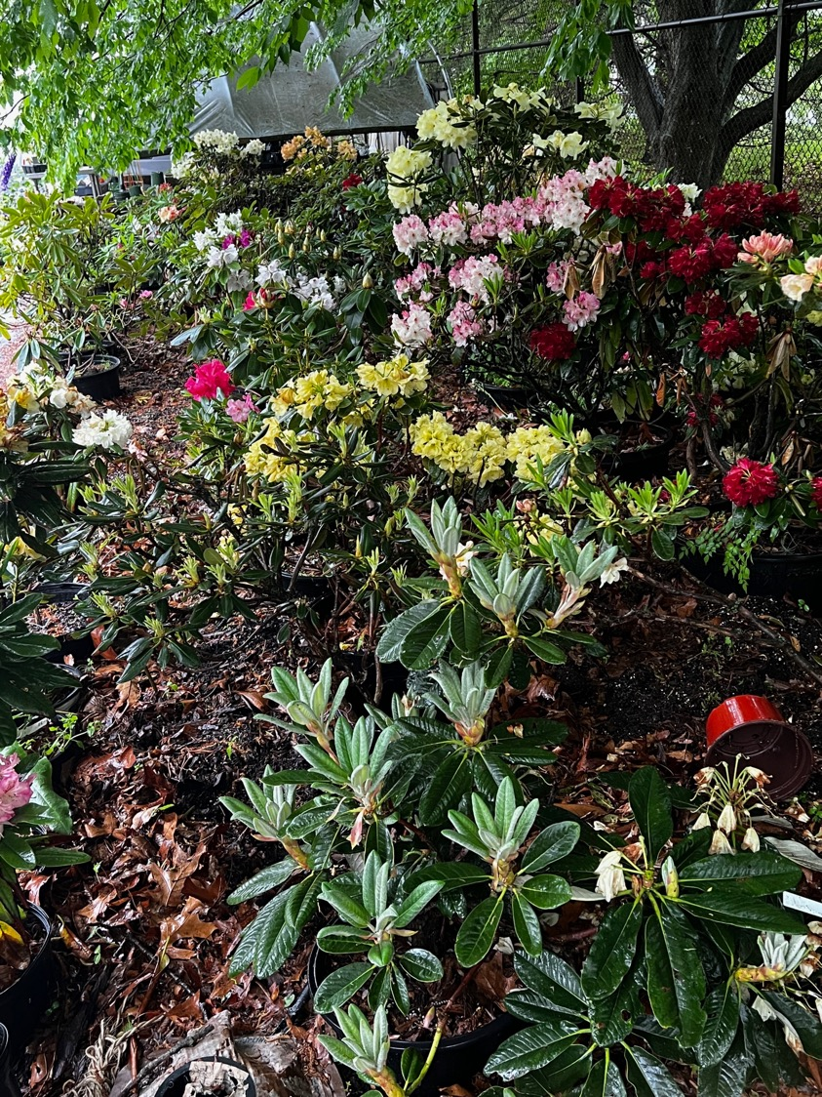
Brachycarpum tigerstedtii x macabeanum

Slide 33
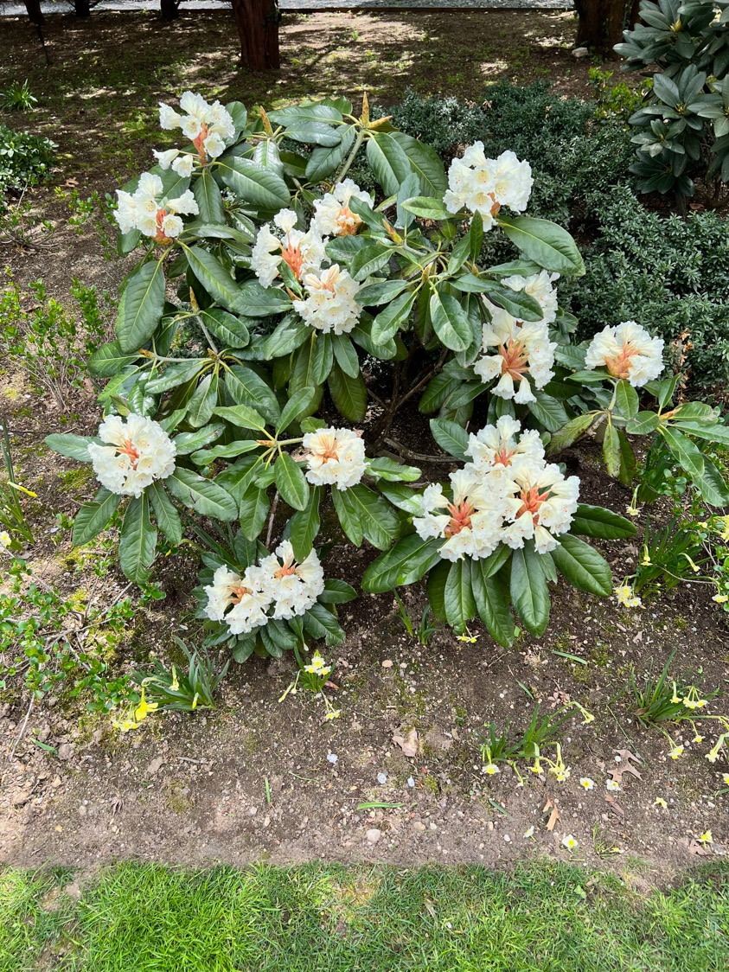
Bracarpum tigerstedtii x macabeanum
Planting Fields Arboretum

Slide 34
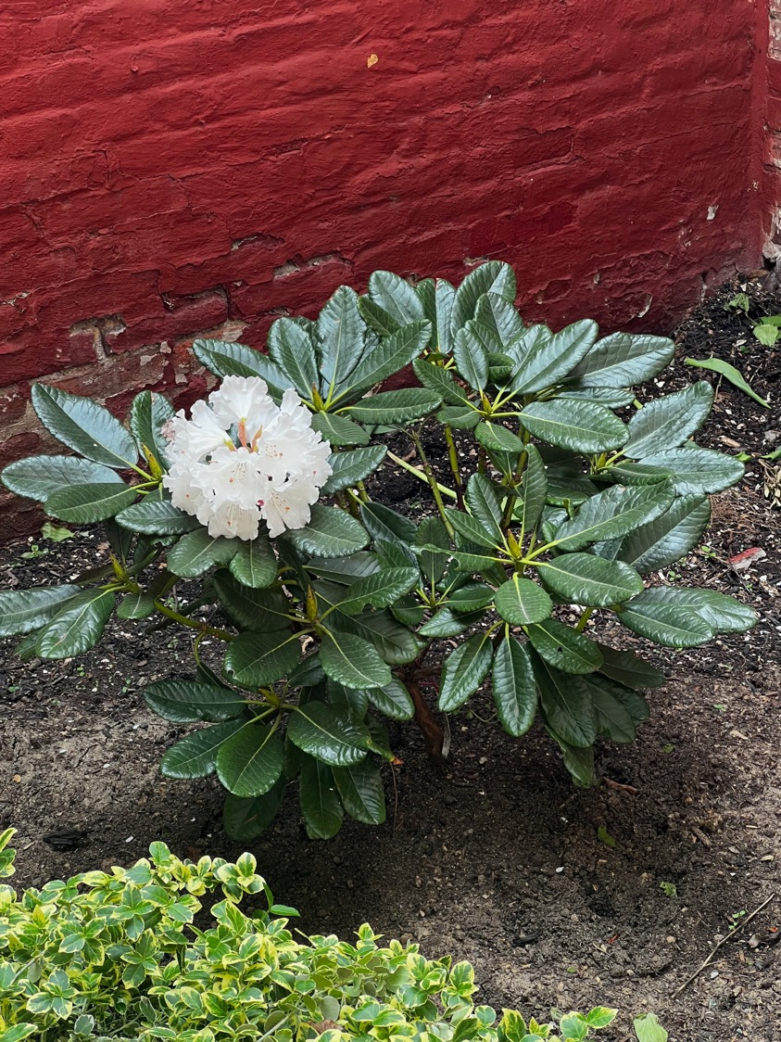
Bracycarpum
tigerstedtii x
mababeanum
x
(hyperythrum x Martha)

Slide 35
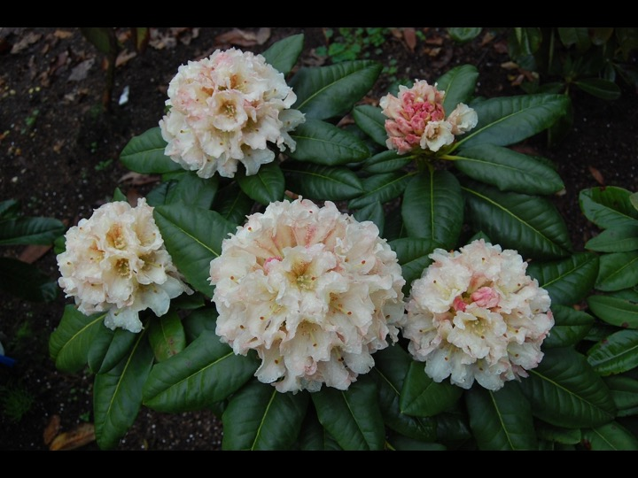
(brachycarpum
Tigerstedtii x
[(Orqnge Marmalade
Percy Weisman)]

Slide 36
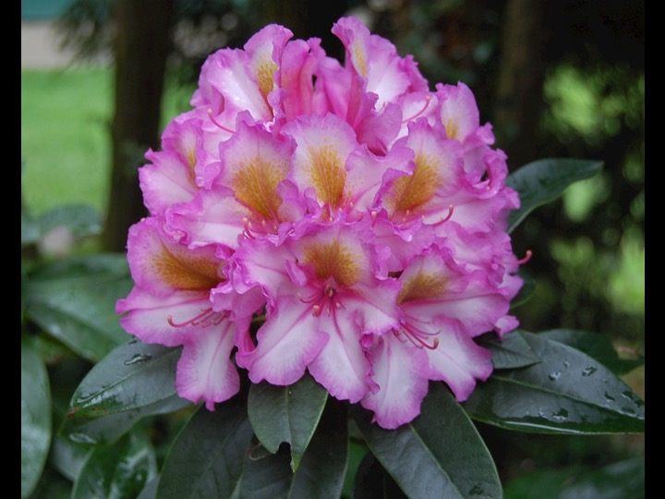
Fantastica x 1000 Butterflies

Slide 37
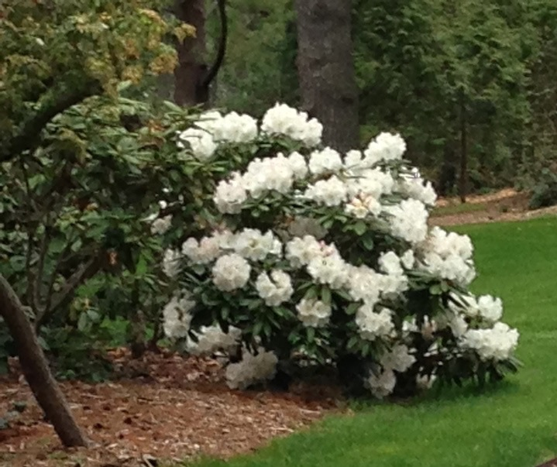
hyperythrum x Martha Phipps

Slide 38
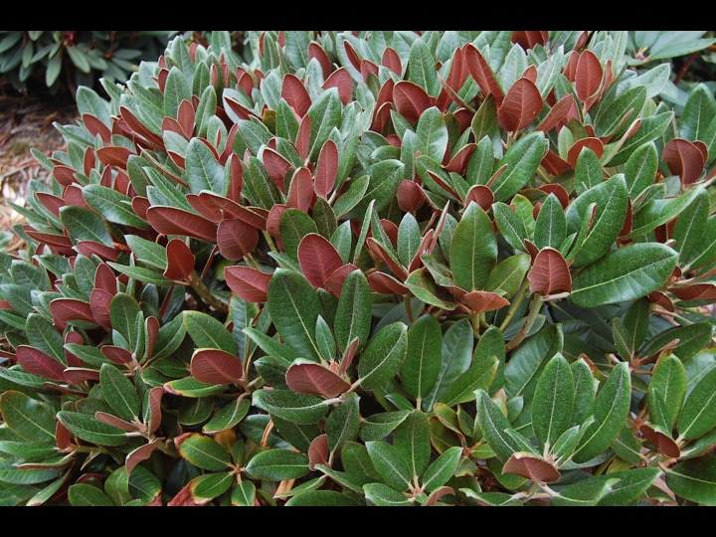
Cherries and Merlot
Fujioka

Slide 39
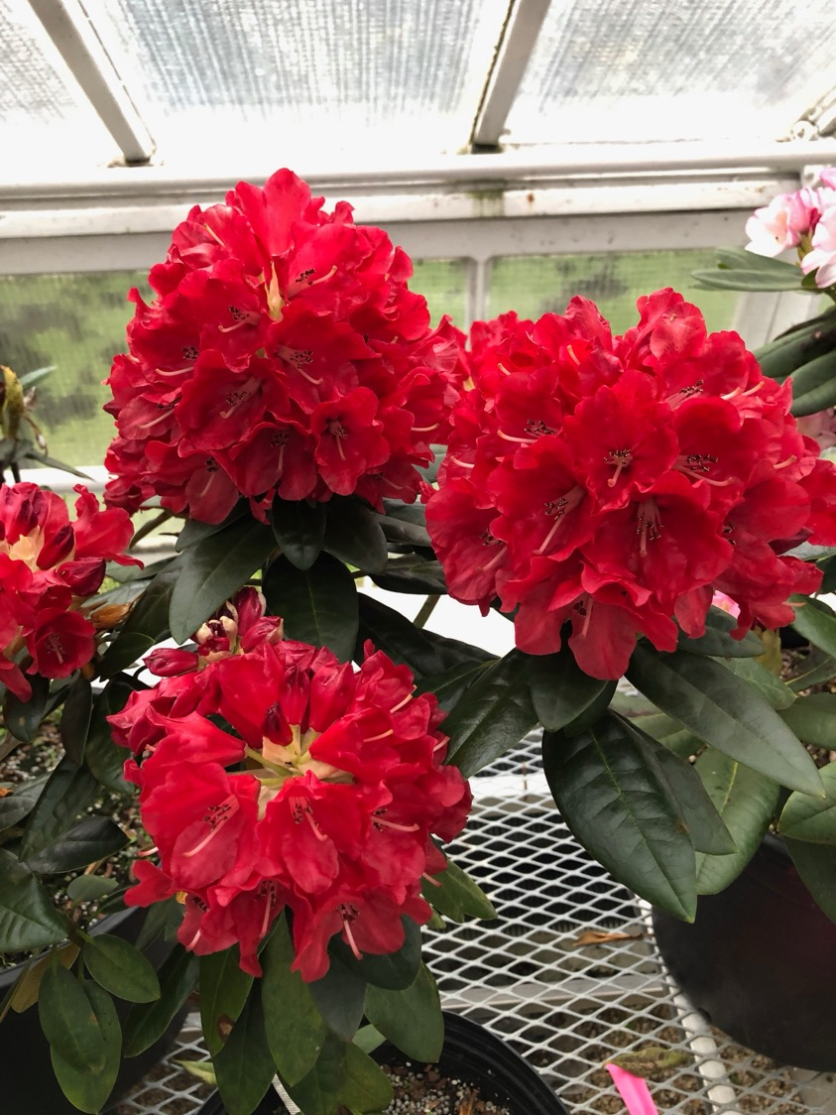
Fantastica x Jan Bee

Slide 40
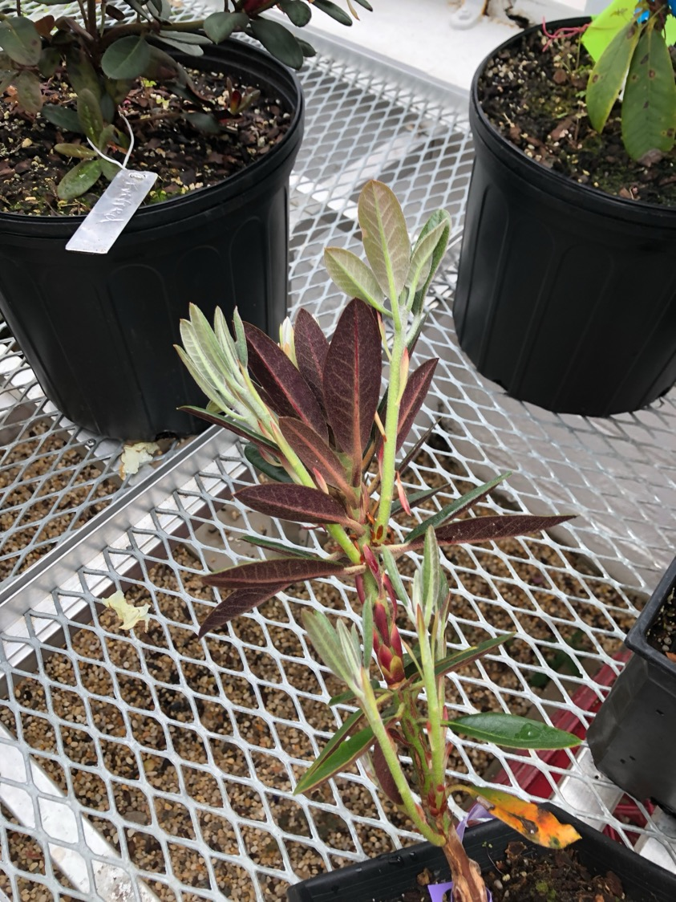
(Fantastica x Jan Bee) x (Cherries & Merlot)

Slide 41
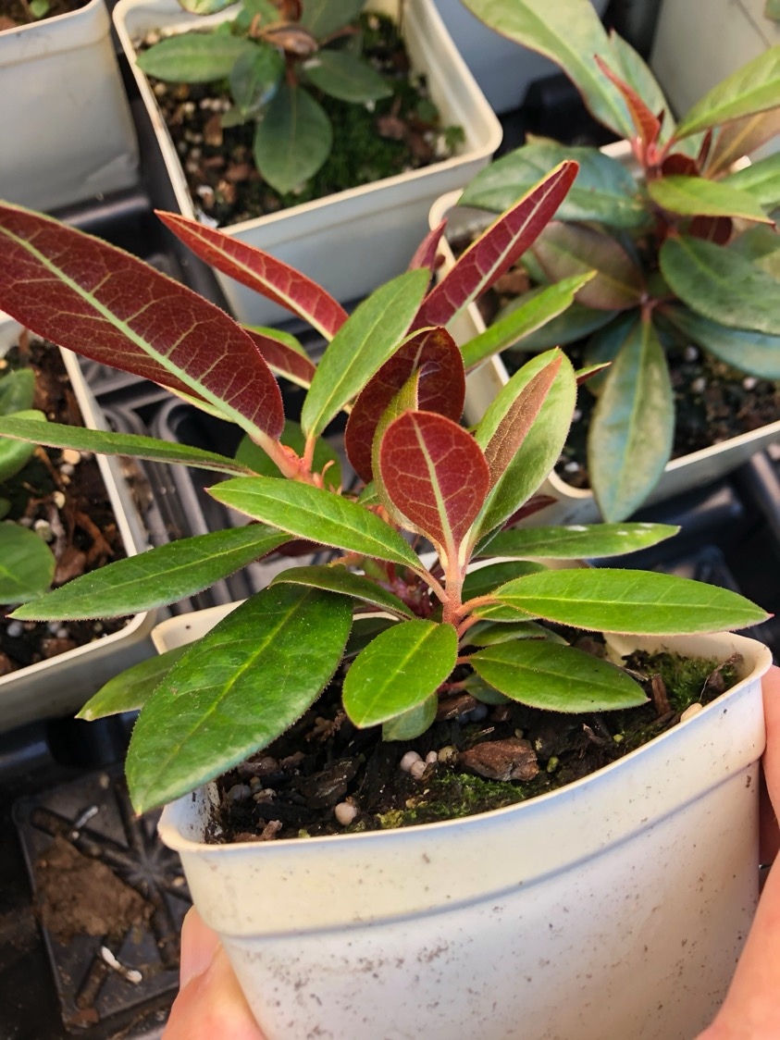
(Fantastica x Jan Bee) x (Cherries & Merlot)

Slide 42
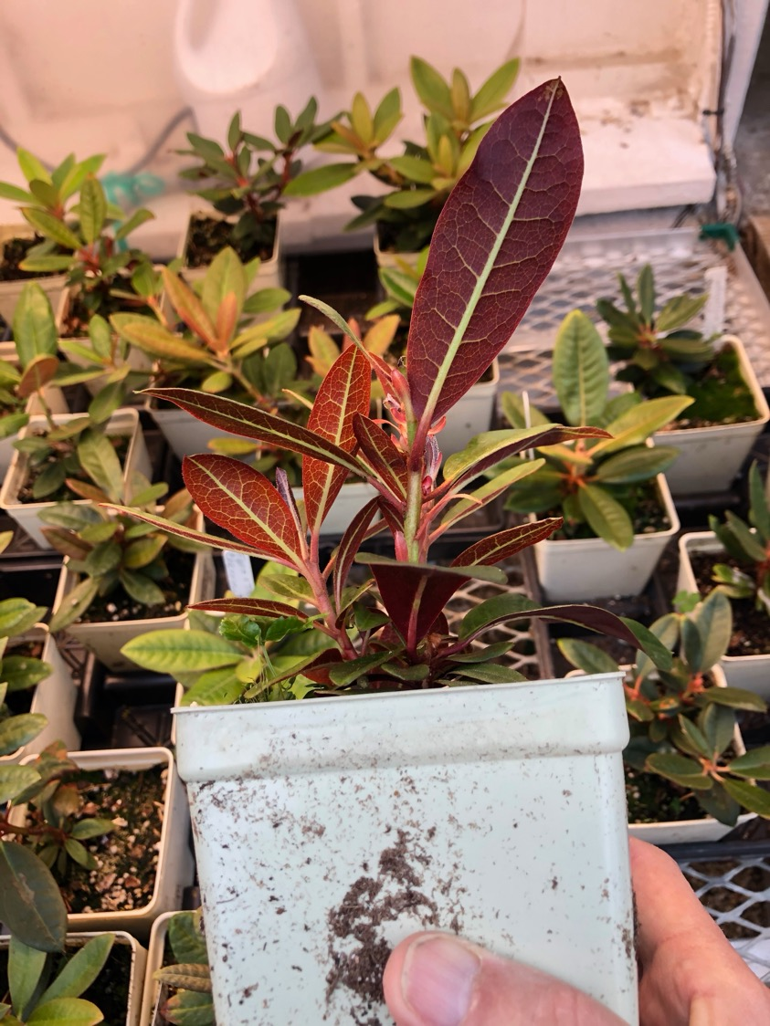
(Fantastica x Jan Bee) x (Cherries & Merlot)

Slide 43
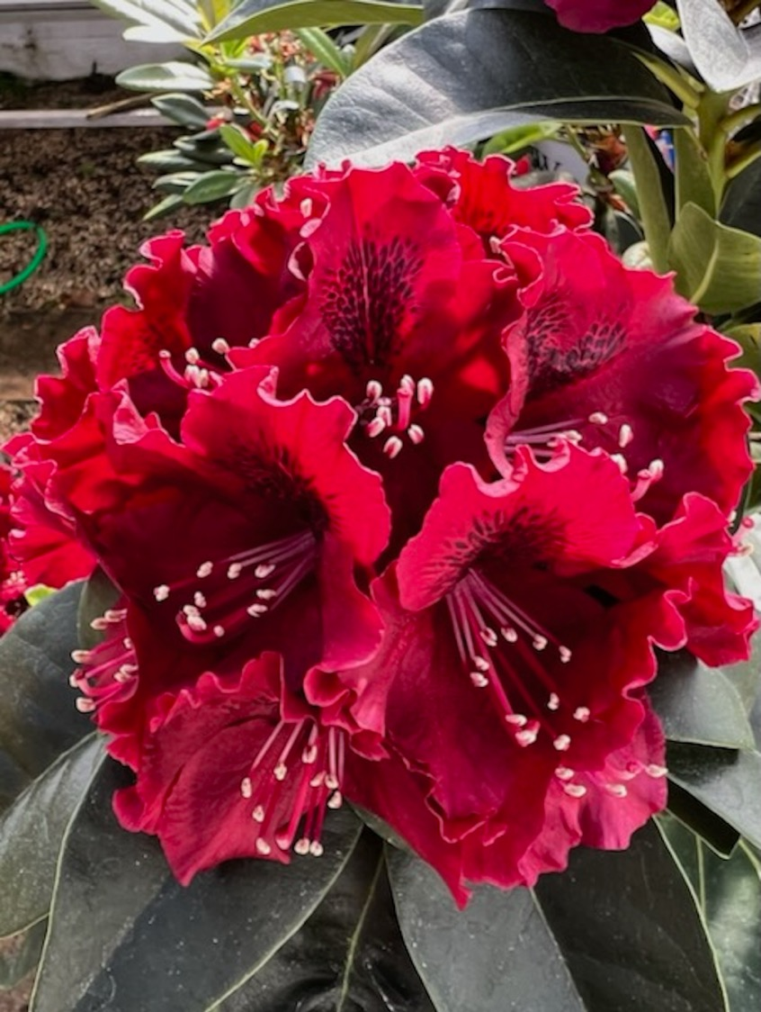
Choco Rojo

Slide 44
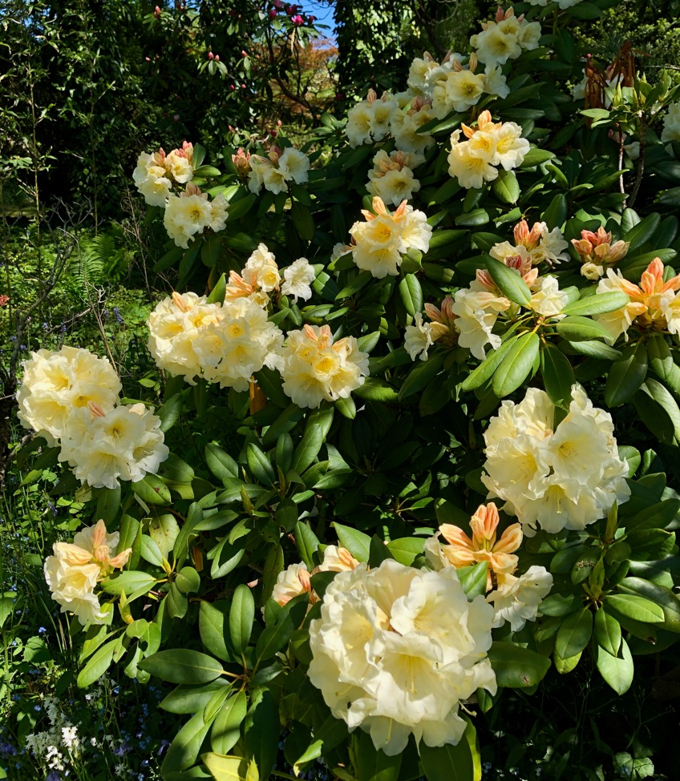
Karen Triplett x Nestucca #2

Slide 45
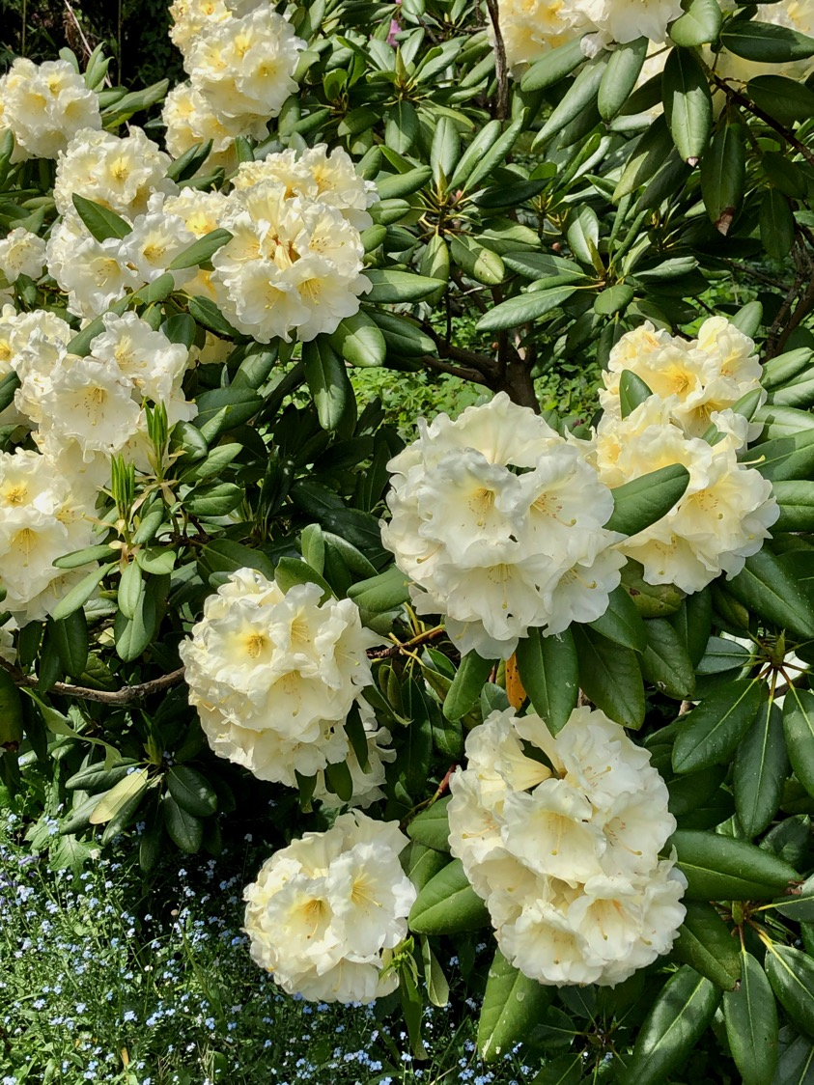
Karen Triplett x Nestucca

Slide 46
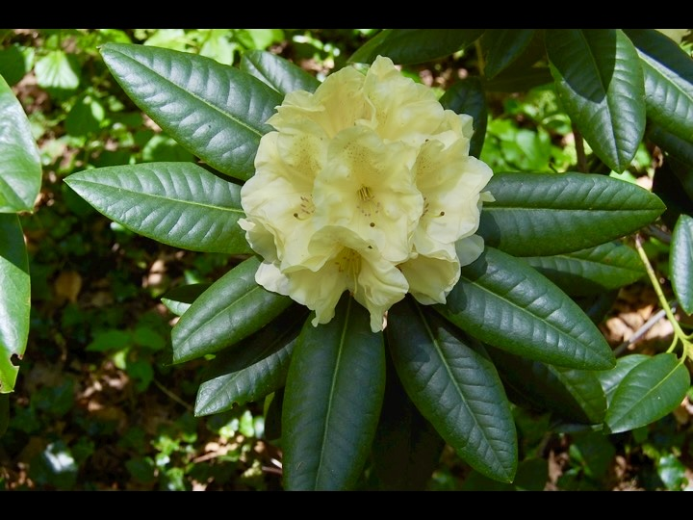
Kristi Lynn
Karen Triplett x
Big Deal

Slide 47
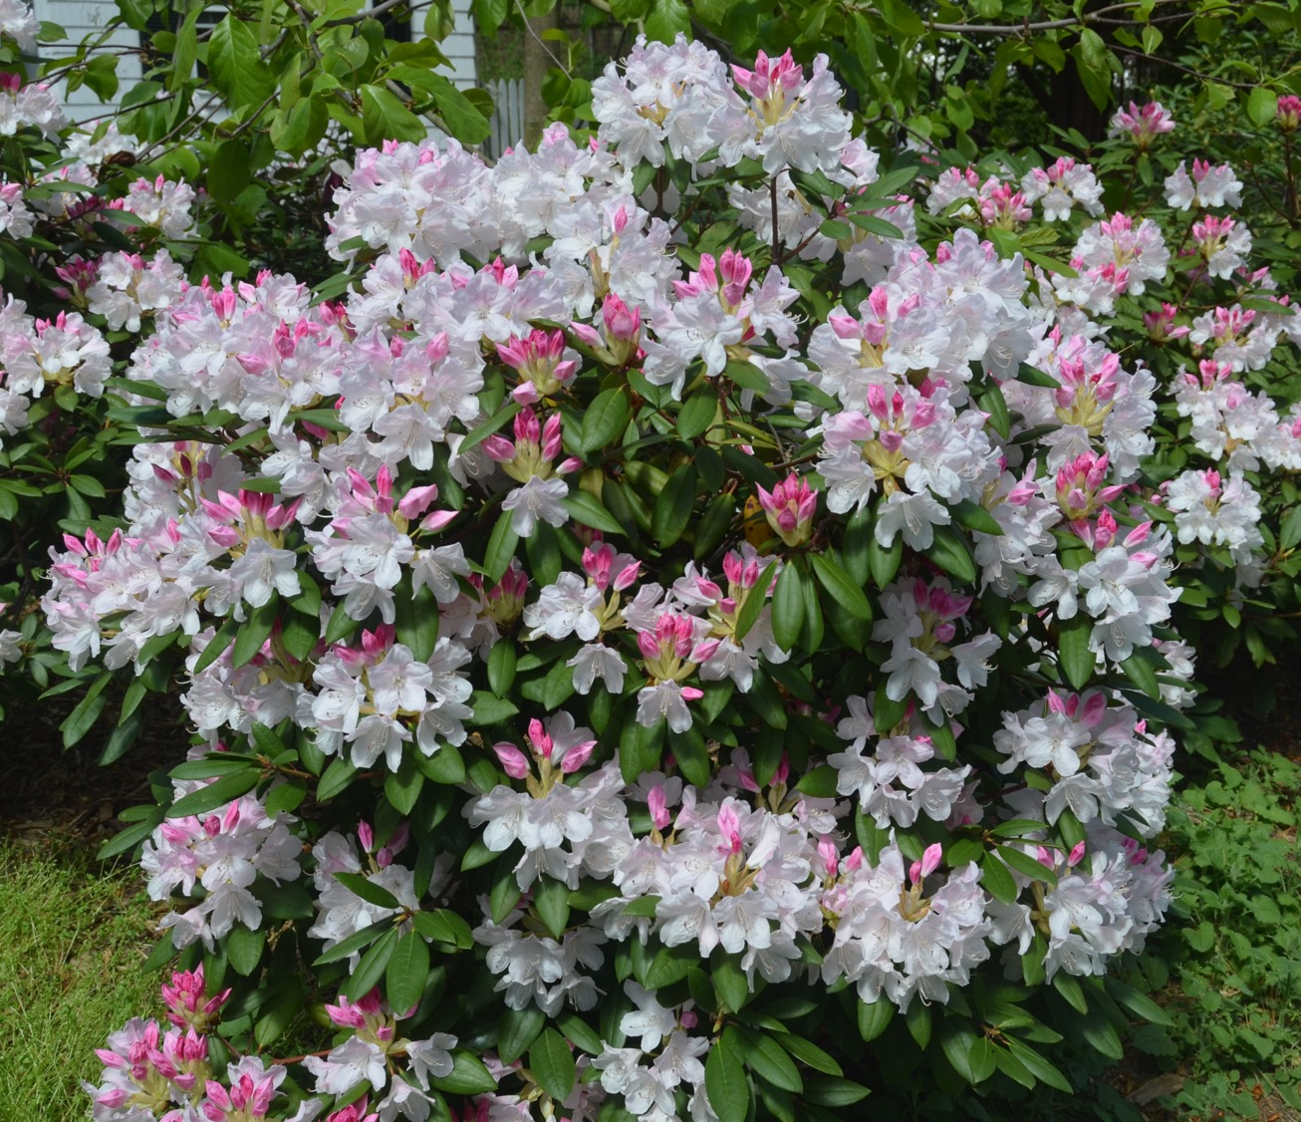
Charles Loomis
(John Thornton)

Slide 48
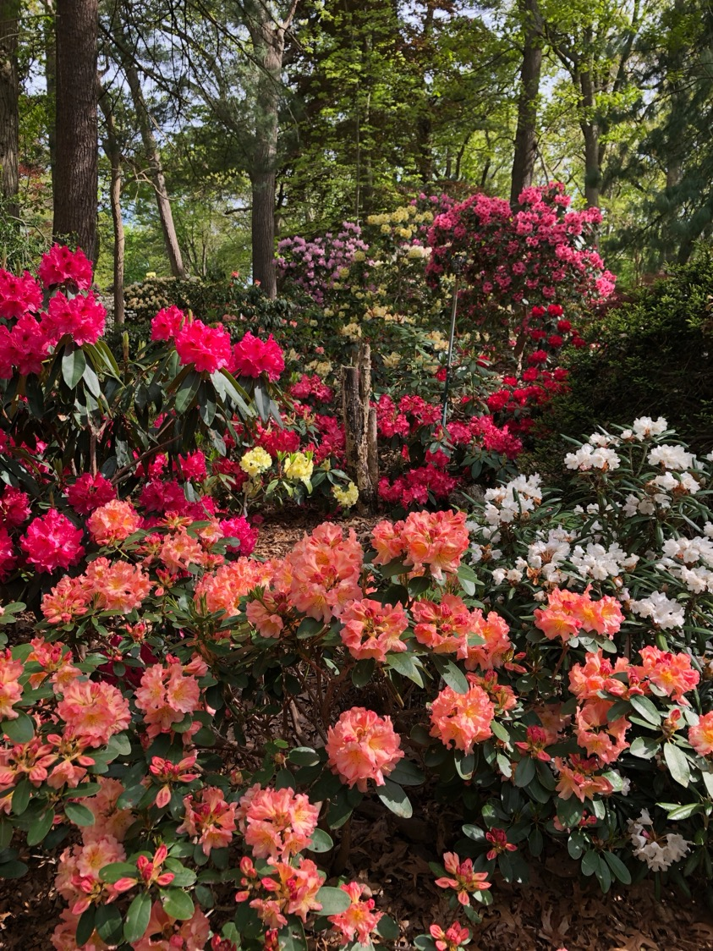
Sundust
Anderson

Slide 49
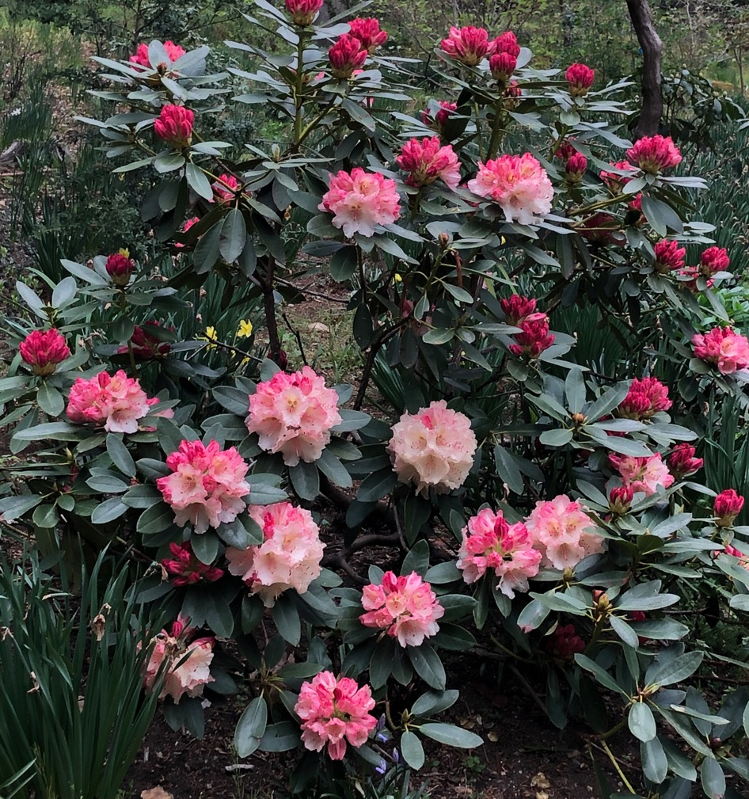
My Catherine
[(Dumper’s yellow x Phipps Yellow) x 1000 Butterflies] x Sonnenchein

Slide 50
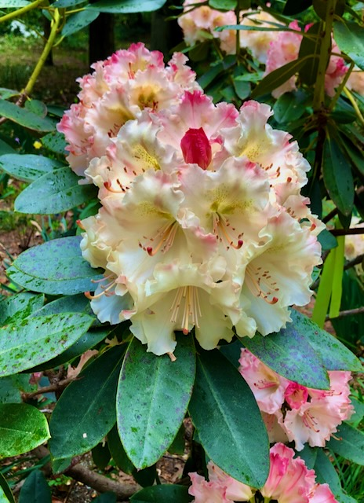
My Catherine
[(Dumper’s yellow x Phipps Yellow)
x 1000 Butterflies] x Sonnenchein

Slide 51


Slide 52

My Catherine
Planting Fields Aeboretum

Slide 53

Offshoot x
(#32 x Viennese Waltz)

Slide 54

Offshoot x (#32 x Viennese Waltz)

Slide 55

Offshoot x
(#32 x
Viennese Waltz)

Slide 56

Grand Recital
Barlup

Slide 57

Offshoot x Lofthouse Legacy

Slide 58

Offshoot x Lofthouse Legacy

Slide 59

Offshoot x
Lofthouse Legacy
Seed set

Slide 60

Ariadne Grace

Slide 61

Janet Blair x [Nancy Evans x
(Whopper x Cameo)

Slide 62

Aureum x lanigerum
Dick Steele

Slide 63

Blue Peter x
Fortunei
Dick Steele

Slide 64

(Consolinis
Windmill x
Unique
Marmalade) x
(Karen Triplett
x Big Deal)

Slide 65

Big Orange #5

Slide 66

Big Orange #5

Slide 67

Bob Schill x unknown yellow hybrid

Slide 68

Bob Schill x
unknown Nancy Evans
yellow nursery

Slide 69

Paprika Spice x
Victorias Consort

Slide 70

Midnite Mystique hybrid
First Bloom

Slide 71

Midnite Mystique Hybrid
34 flowers/truss

Slide 72

Hachmann
DarkBlue

Slide 73

Hachmann
unknown

Slide 74

Hachmann
Marenga

Slide 75

Eye of the
Tiger
Hachmann

Slide 76

Scarlet Leopard
Don Wallace
Singing Trees Nursery

Slide 77


Slide 78


Slide 79


Slide 80

(Janet Blair x #32) x (Orange Marmalade x
1000 Butterflies)

Slide 81

(Offshoot c Lofthouse Legacy)
x [(offshoot x (#32 x Vienese Waltz)

Slide 82

Lost Label

Slide 83

[(Ap Fantasy x Buds Yellow)
x (Brasilia x Viennese Waltz)
x Babylon

Slide 84

Lost label

Slide 85

Whitestone x
(yak x #32)

Slide 86

(Whitestone x Avalanche type) x Mary S Phipps

Slide 87

Whitestone x (yak x #32)

Slide 88

Whitestone x White Peter

Slide 89

Jim Barlup hybrid

Slide 90

Nobi Max
(Karen Triplett x Big Deal#3) x
[(Yak x #32) x V Waltz] x Gosh Darn)

Slide 91

Hubba Hubba
(J Blair x #32) x
(Orange Marmalade x
1000 Butterflies)

Slide 92

Hubba Hubba #2

Slide 93

Diana Marguerite

Slide 94

Diana Marguerite

Slide 95

Diana Marguerite x
Peggy Roberts
Barlup

Slide 96

Vinnie Simeone, Director of Horticulture
Planting Fields Arboretum, Oyster Bay NY
with Diana Marguerite

Slide 97

Diana Marguerite hybrid

Slide 98

Nobi Max

Slide 99

Karen Triplett x Nestucca

Slide 100

Apricot Fantasy x Martha Phipps
Murcott
Mislabelled

Slide 101

Charmont x Babylon

Slide 102

(Whitestone x yak) x #32
double

Slide 103

Mary S. Phipps
Scintillation x (Pink Petticoats x yakushimanum)

Slide 104

Mary S. Phipps x Avocet

Slide 105

Mary S. Phipps at Longwood Gardens

Slide 106

My Catherine opening

Slide 107

Fujioka
Golfer type

Slide 108

Golfer

Slide 109

Hachmann’s display garden

Slide 110

Fujioka’s version of Golfer

Slide 111

Fujioka
bureauvii x pachysanthum

Slide 112


Slide 113

Fujioka rejects

Slide 114

Silver Velour

Slide 115


Slide 116

Frank Fujioka

Slide 117


Slide 118


Slide 119

Kernehuset
Copenhagen

Slide 120

Seaview Sunset
Fujioka

